Slide 1


eEVA Data Generation and User Results Analysis v1.0
Final Presentation
Senior Project- Fall 2016
Team Members: Carlos Mestre, Stephanie Lunn Product Owner: Christine Lisetti
Mentor: Mohsen Taheri
Instructor: Masoud Sadjadi

Slide 2
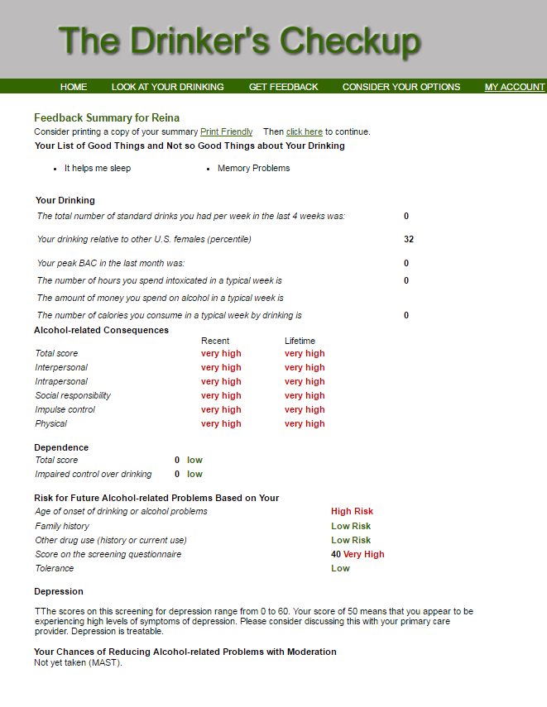
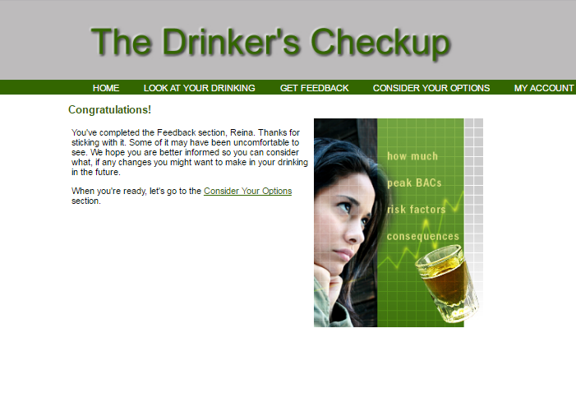
(Hester, Squires, Delaney, 2005)
Original Drinker’s Check-Up
Notes:
10 seconds. Issues with original DCU
Many times, heavy drinkers are unaware that they have an issue. Brief motivational
interventions have been shown to be effective at reducing problem drinking
(Hester, Squires, Delaney, 2005). However, the original version of the
Drinker’s Check-Up (DCU) is text only (http://drinkerscheckup.com/), and the
results are delivered in dense blocks with no explanations of what they mean.

Slide 3
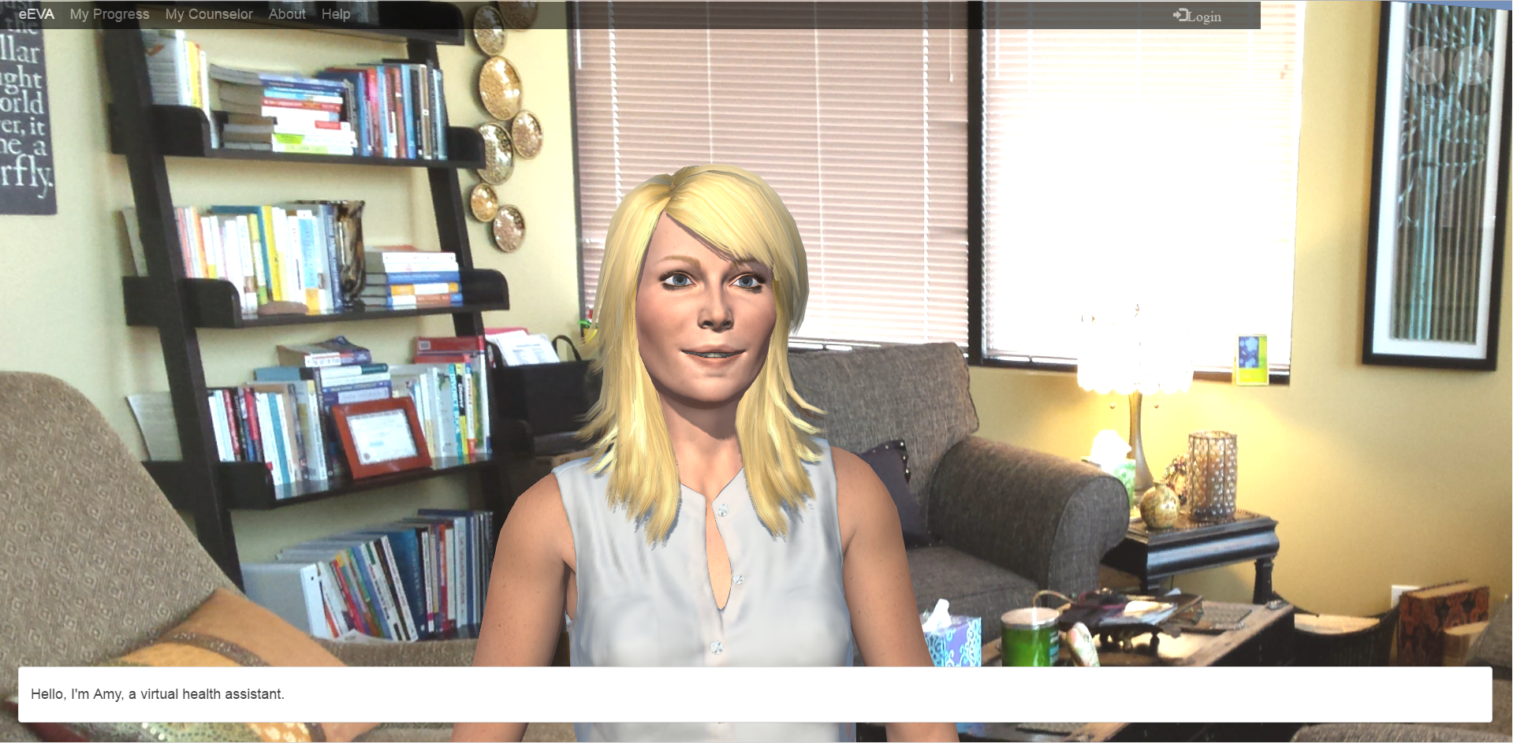
Project Definition
How to improve on the original DCU?
Use an empathic embodied virtual agent (eEVA) to make the system:
Interactive
Context Given
Engaging Counselor
Notes:
20 seconds.
In order to engage users, why not design a virtual health agent to administer the questionnaire and deliver results? Should could build a rapport with users and help them to reveal sensitive material. To better describe what the users’ scores mean on the assessments, she can provide better explanations and interactive displays when giving them feedback. In the first version of eEVA, the team members worked hard to improve eEVA’s implementation, and to begin working on how she will convey the results.
Make it more interactive and engaging with an empathic embodied virtual agent (eEVA)
Interactive features
Tables
Checkbox questionnaire
Contextual features
Give users meaning behind results
Provide exchanges with the counselor regarding test scores

Slide 4
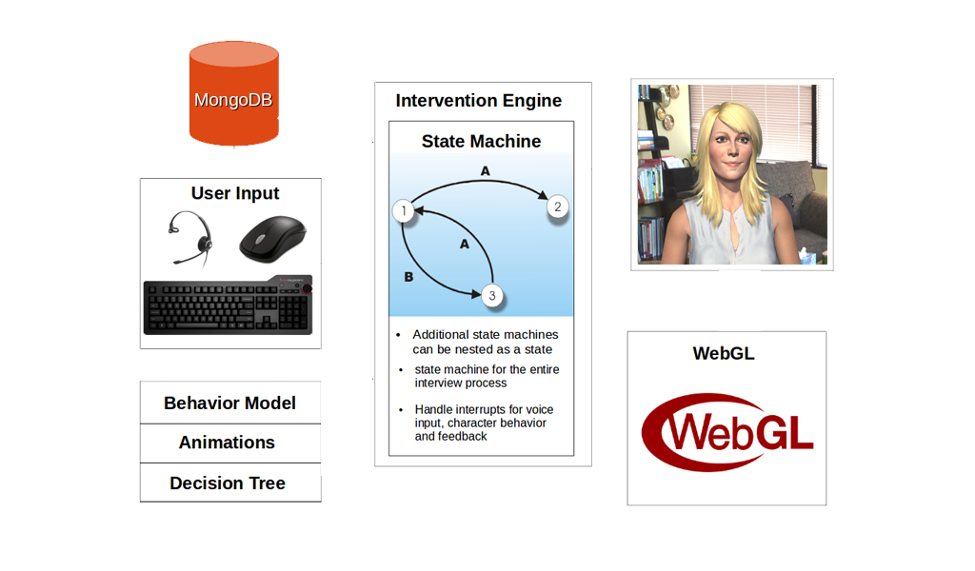
How does it work?
Notes:
20 seconds
While the entire system is quite complicated, the basic premise is that an administrator can edit intervention content for drinking or other problem behaviors in the survey editor. Then, the administrator will place these elements into a state machine, while then stores content to a MongoDB. This state machine however, enables the graphic character, allowing her to speak the material she is programmed with. The end result is rendered with WebGL to deliver an interactive, and engaging user experience

Slide 5
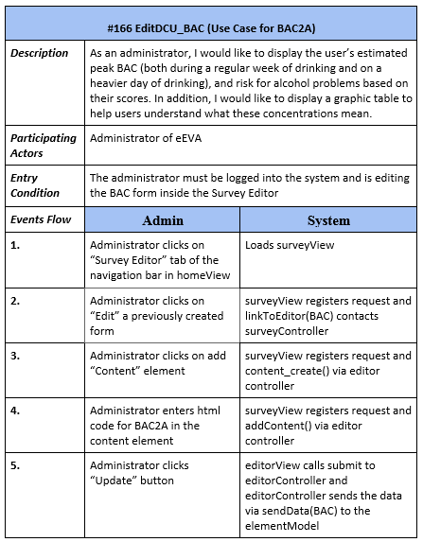
Sample Use Case:
Blood Alcohol Concentration
Use Case Structure
Description: detail the objective of the individual use case from the user story
Participating Actors: who will be the focus of this activity
Entry condition: what steps are necessary for this action to take place
Events Flow: how does the Actor engage with the eEVA system
Notes:
5 seconds
Discuss the Purpose, Actors, entry condition, and then…how it is implemented

Slide 6
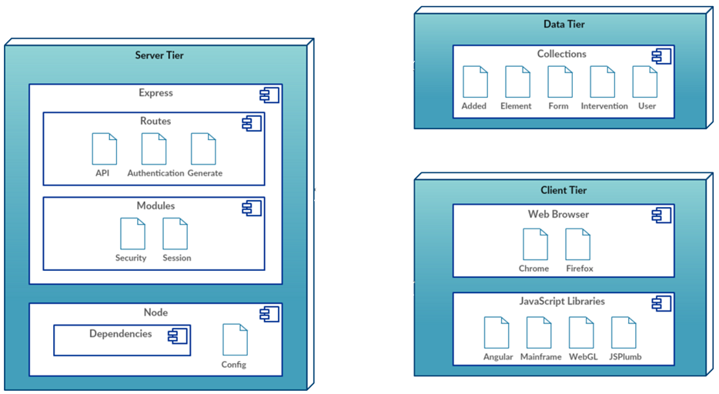
System Design:
Deployment Diagram
Notes:
20 seconds
The framework for the system was created by the Affective Social Computing Laboratory (ASCL), using a MEAN Stack. Using a Model View Controller architecture, the system is divided into a Mongo database that stores the data in the tables mentioned (added, element, form, intervention and user). Then at the Server tier, Express contains both Routes and Modules. Then Node is used as the framework, consisting of the server congifuration and dependencies. The client tier is what the user gets to interact with, displaying the views presented. The site can be launched via Chrome or Firefox, and the necessary Javascript libraries render the WebGL avatar

Slide 7
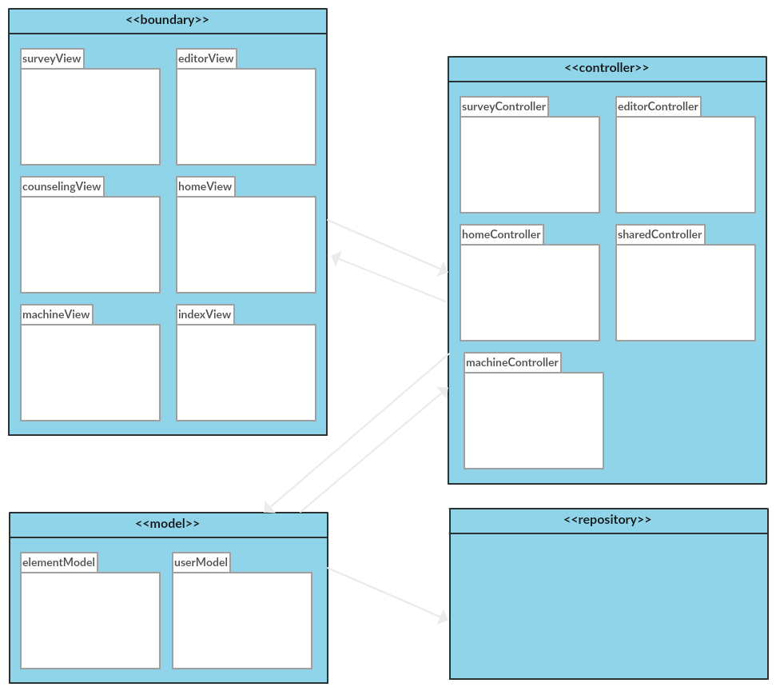
System Design:
Minimal Class Diagram
Model View Controller
Model manages the data, logic, and rules of the application
View generates new output to the user based on changes in the model
Controller sends commands to the model or the view to update its presentation
Repository stores the data from the eEVA system
Notes:
10 seconds. Minimal class diagram.
We mostly implemented items in the survey editor and state machine, which were rendered primarily in the surveyView and editorView. These were controlled by the respective surveyController and editor Controller, which used updated the content into the repository. However, the other views mentioned like the counseling View were necessary to display the modified content to system users as well.

Slide 8
User Stories
EditDCU_BAC
AddElement_Next
EditDCU_Consequences
ModifiyContentStyling
EditDCU_RiskFutureProblems
Notes:
5 seconds.
List the user stories that you worked on them.(put in order of importance). Stay focused on the parts that you have been working.

Slide 9
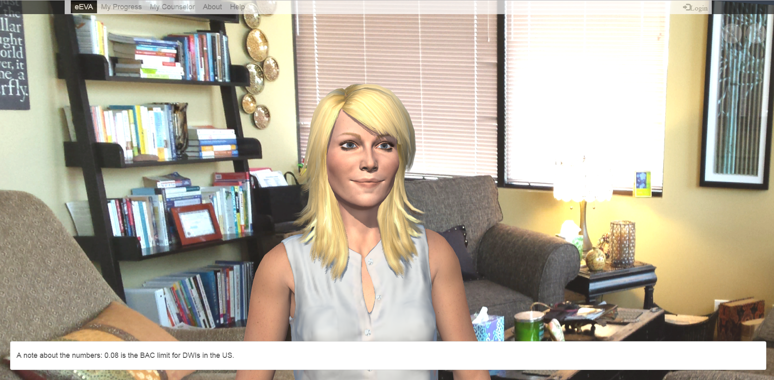
User Story #166_EditDCU_BAC
Our First Large Scale Conversion:
Counselor spoken introduction to the section
Results provided from database with graphical representation of health impact
Checkbox question to calculate user’s feeling regarding results
Interactive table to calculate user’s common BAC level, allowing printing to occur as well
Notes:
60 seconds
Our most ambitious story was the EditDCU_BAC, which stands for Blood Alcohol Concentration. This user story was particularly difficult considering there were 3 pages within this section, each of which required implementation of elements we hadn’t yet figured out how to make work with our system.
Since we were using a survey editor and state machine, content had to be entered into the forms. However, the body is injected into an html form, and sometimes addition of certain javascript components were met with resistance by the system.
In the BAC2B page, we needed to find a way to display a unique response based on a user’s selection about their reaction to their results. Several attempts that would work in other Javascript editors were met with resistence inside the content element of eEVA. Finally we were able to get this working, but it took longer when we realized a user could select multiple items and they would all display in one large block. This was resolved so that instead it cleared out when more than one choice was made.
In addition, adding a print function to the third BAC page cause a problem in which the toggled counselor took the entire screen. Since the entire system is actually all in one page, a reset function caused the entire state machine to begin anew, starting the counselor from her first state. To resolve the print we finally had to add a print function into the entire system, to call it from within the html code of the content element so that it could place the particular table in its own div to allow it to be printed properly.
Please present and show the complexity of your work, code, algorithms, and technical challenges and technologies you have used. (you could use screenshot if you want. Visual presentations are better than text presentation) - Go into the details of the most important/significant tasks using bullet lists or visual graphs or state chart diagram - Demo using screenshots or GIF (in another separate page if required)
Sequence Diagram for this user story is optional

Slide 10
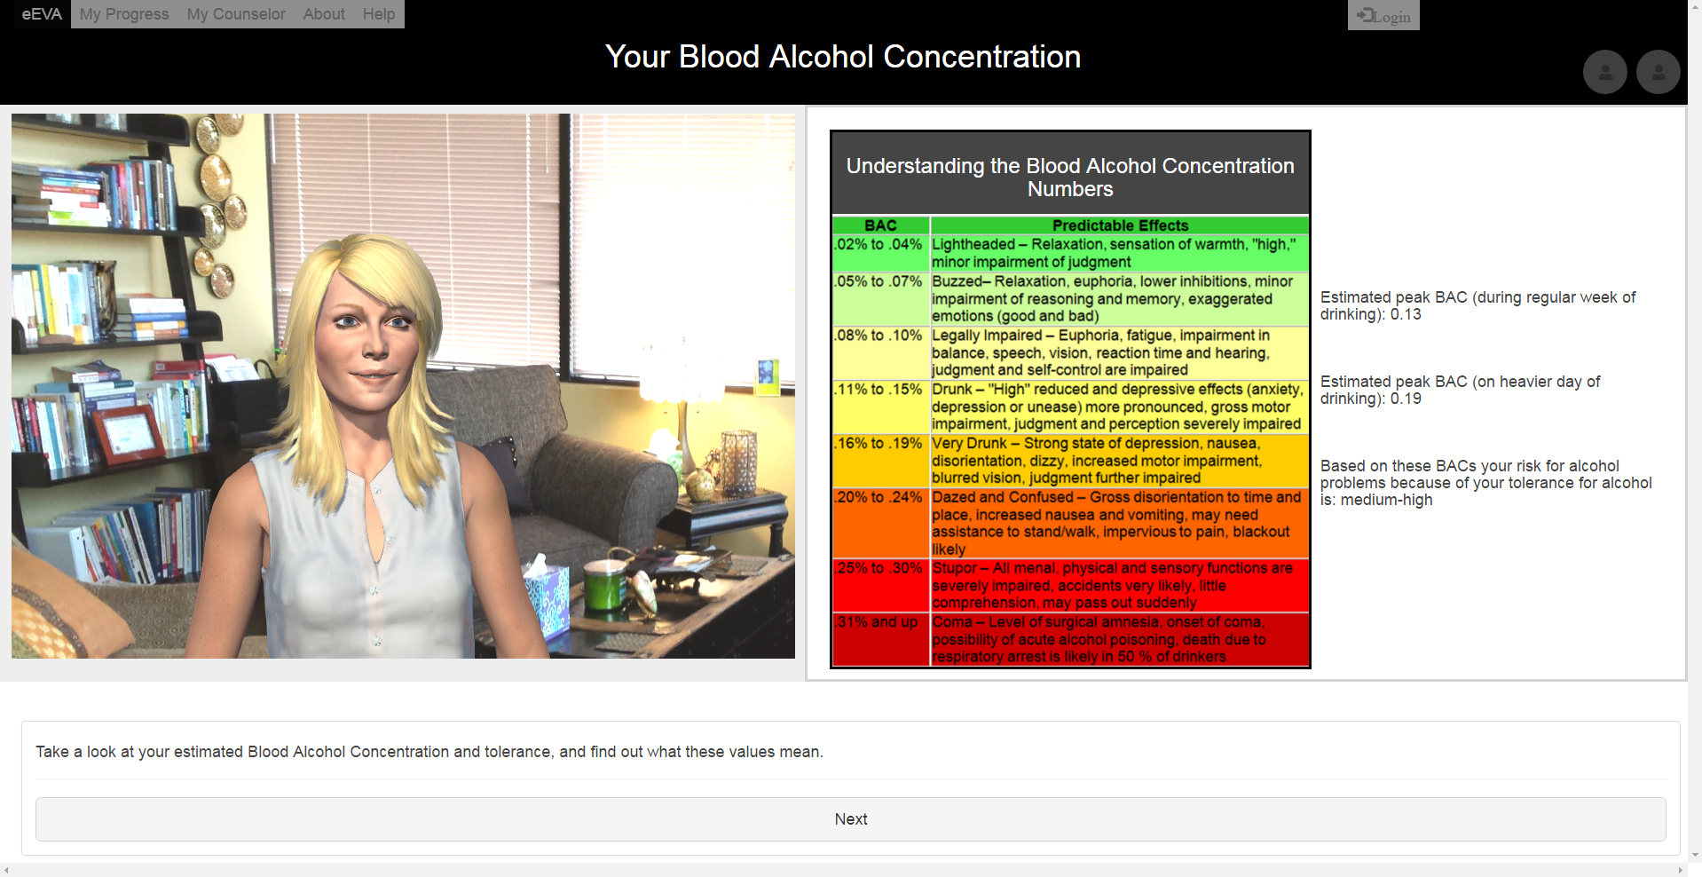
User Story #166_EditDCU_BAC

Slide 11
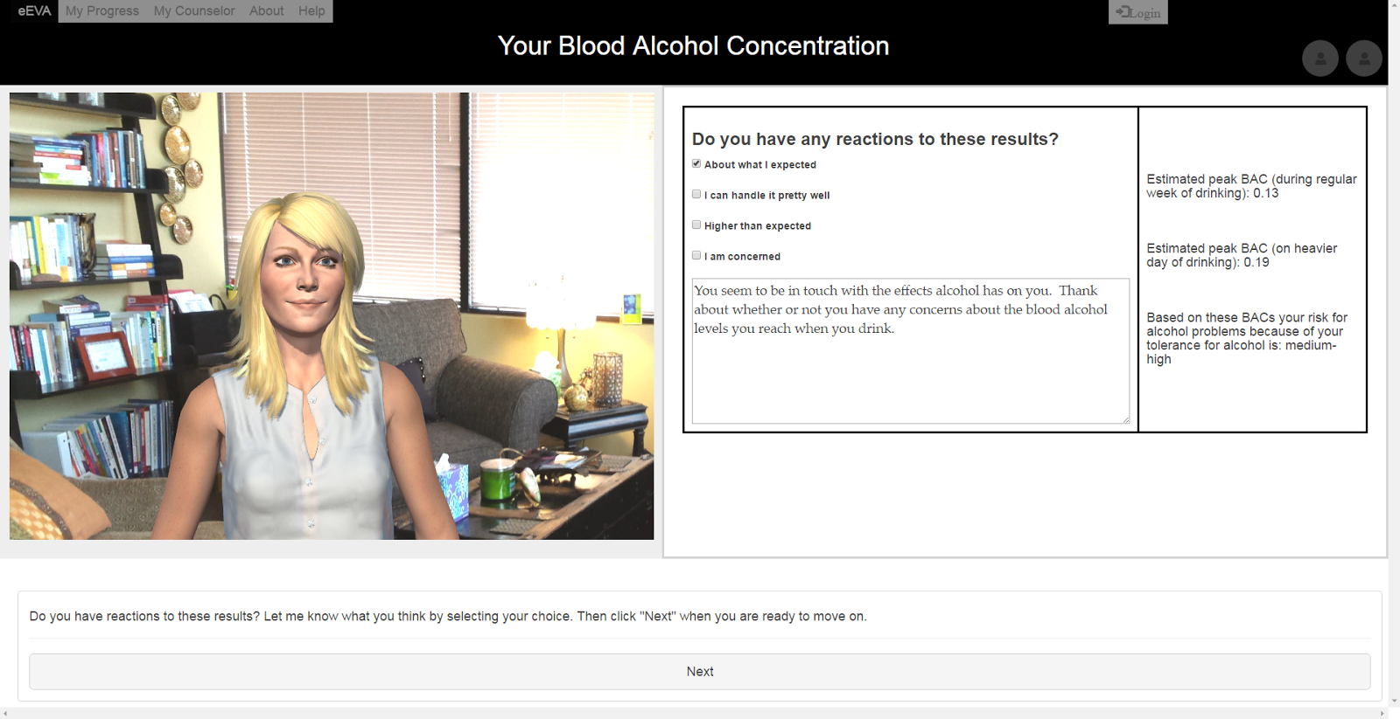
User Story #166_EditDCU_BAC

Slide 12
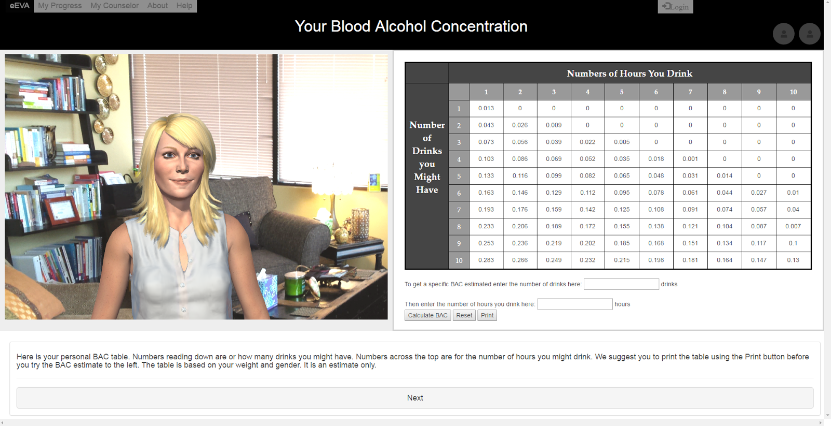
User Story #166_EditDCU_BAC

Slide 13
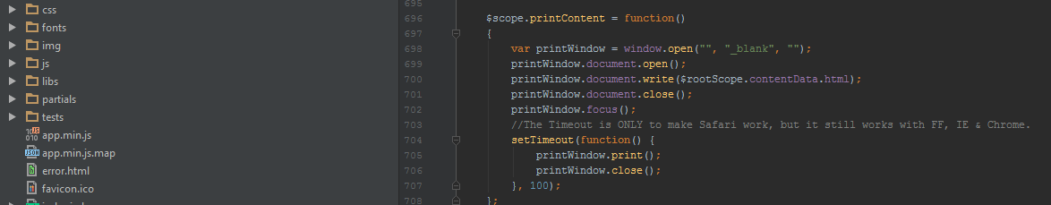
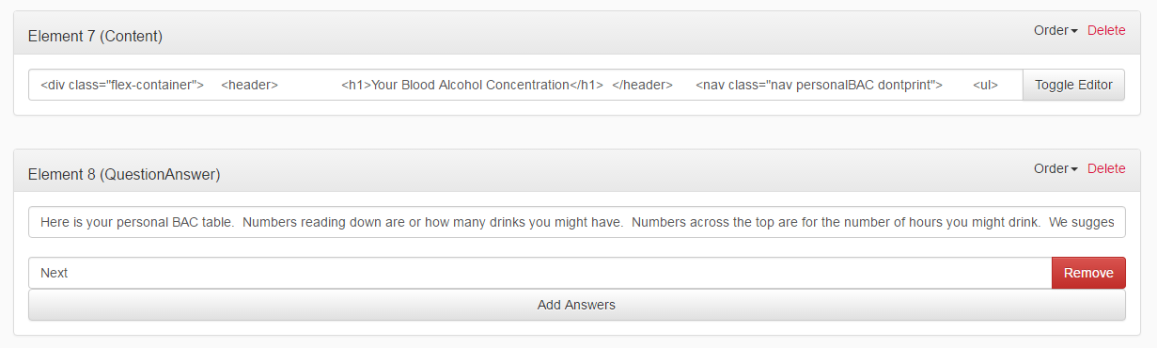
Print Function
Notes:
Take a look at the print function, which needed to be added to the counseling.controller in the client tier. Then, the html code to call this was entered into Element 7 (the content window) shown

Slide 14
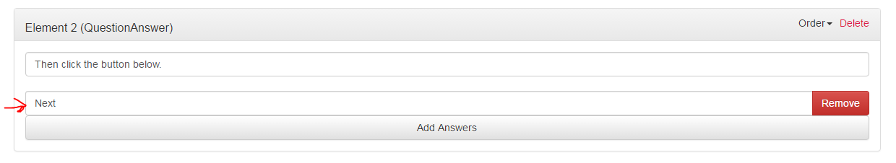
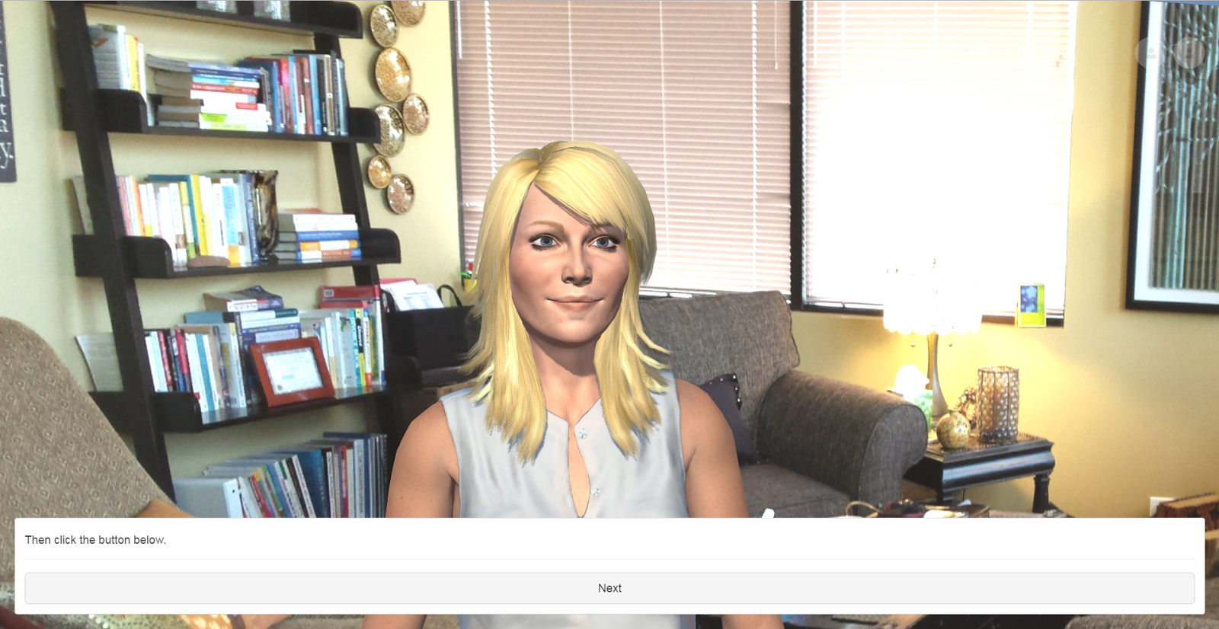
User Story #133
AddElement_Next
Notes:
20 seconds
AddElement_Next
In order to create a better way to proceed through content, a button was needed. The system only had an option for Question and answers, which made multiple choice sections appear that looked strange with only one choice bubble. Creating an entirely new element limited the text options, and to work around this
To rememdy the situation, we altered the question and answer element so that a since answer would allow us to create a button instead. That way the content could be changed to display a proper button whenever needed

Slide 15
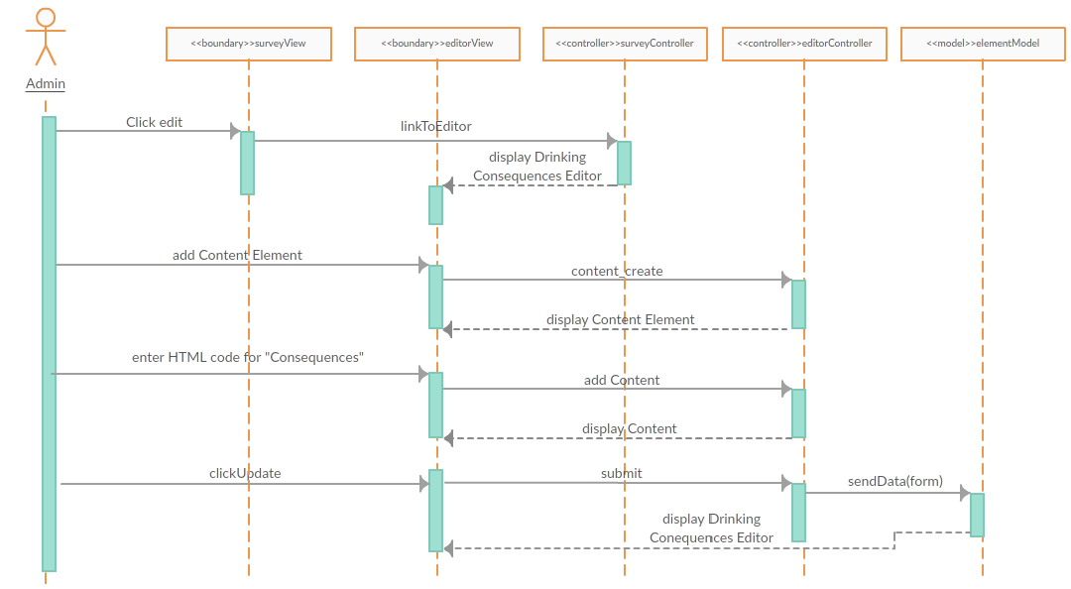
User Story #199
EditDCU_Consequences
Notes:
20 seconds
EditDCU Consequences
As part of the delivery of the user’s scores on the various assessments in the results, the counselor will need to relay information about the user’s alcohol-related consequences. The administrator needs to be able to edit this content to elucidate the recent and lifetime consequences of the user’s drinking pattern.
First the Administrator clicks on “Edit” on Drinking Consequences
Then the system surveyView registers request and linkToEditor(Drinking Consequences) contacts surveyController
Afterwards, Administrator clicks button to add “Content” element , which in the system, surveyView registers request and content_create() via editor controller and new content box appears in editor view
Then Administrator enters HTML code for “Consequences” in content and the surveyView registers request via editor controller
Finally, the Administrator clicks “Update” button and then in the sytem, editorView calls submit to editorController and editorController sends the data via sendData(form) to the elementModel. Content is updated and editor view stays present

Slide 16
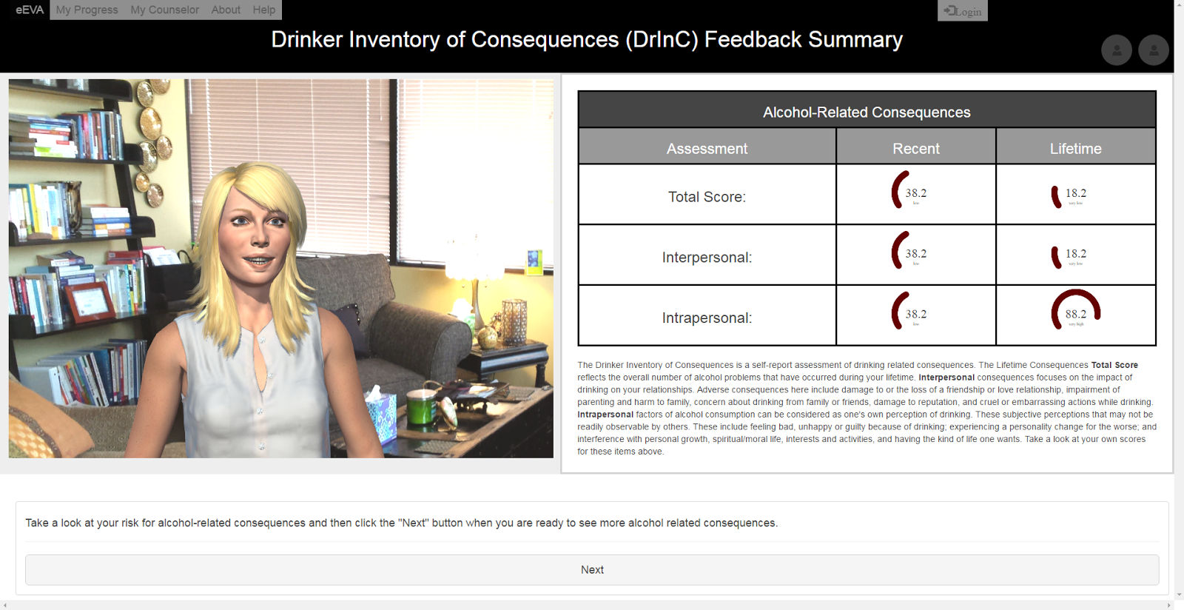
User Story #199
EditDCU_Consequences
Notes:
20 seconds
EditDCU Consequences
The end result can be viewed here, and for this user story, we had to find a Javscript library to display gauges that would be allowed by the system.

Slide 17
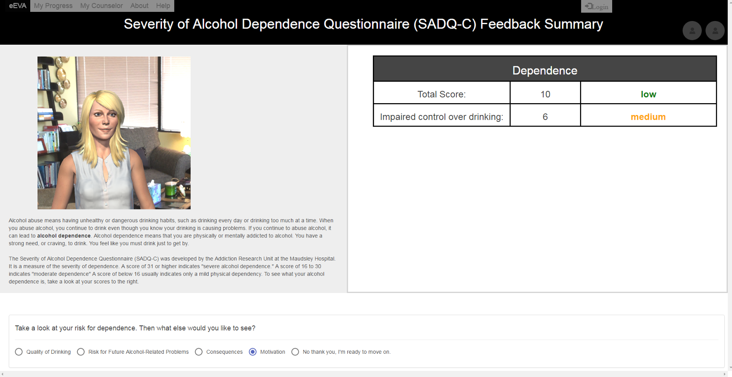
User Story #234
ModifyContentStyling
Original
Notes:
20 seconds
Modify Content Styling
Please present and show the complexity of your work, code, algorithms, and technical challenges and technologies you have used. (you could use screenshot if you want. Visual presentations are better than text presentation) - Go into the details of the most important/significant tasks using bullet lists or visual graphs or state chart diagram - Demo using screenshots or GIF (in another separate page if required)
Sequence Diagram for this user story is optional

Slide 18
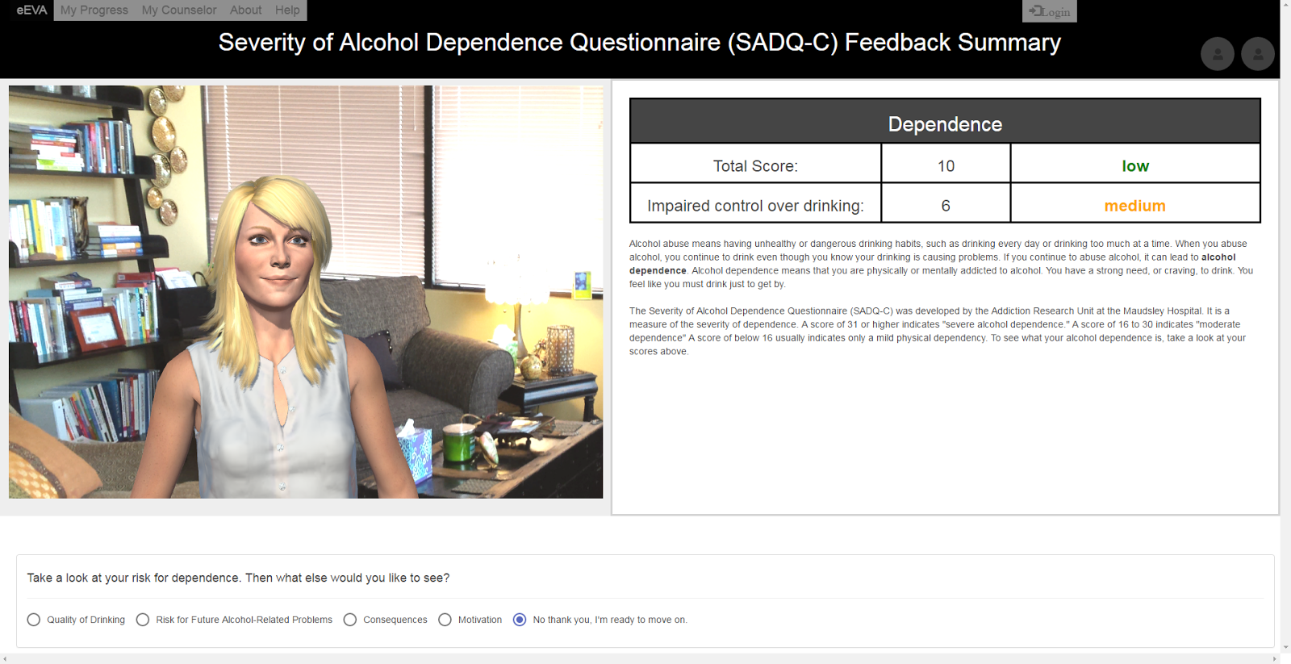
User Story #234
ModifyContentStyling
Revised Styling
Notes:
20 seconds
Modify Content Styling
Please present and show the complexity of your work, code, algorithms, and technical challenges and technologies you have used. (you could use screenshot if you want. Visual presentations are better than text presentation) - Go into the details of the most important/significant tasks using bullet lists or visual graphs or state chart diagram - Demo using screenshots or GIF (in another separate page if required)
Sequence Diagram for this user story is optional

Slide 19
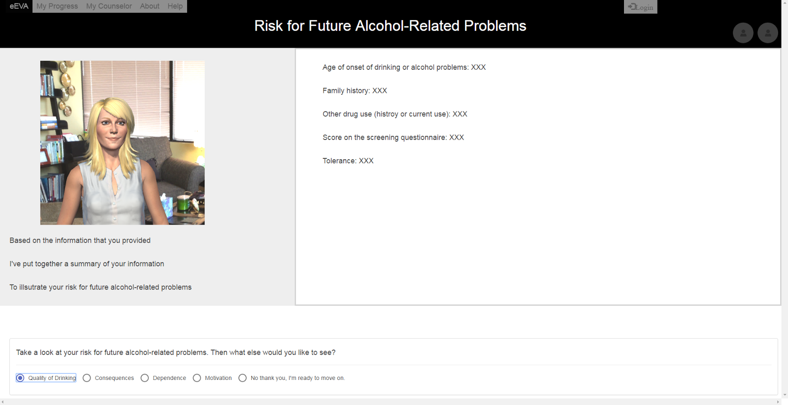
User Story #198
EditDCU_RiskFutureProblems
Original
Notes:
20 seconds
RiskFutureProblems
We originally included only the content like the basic text-only DCU, however, we later decided to improve upon it by adding

Slide 20
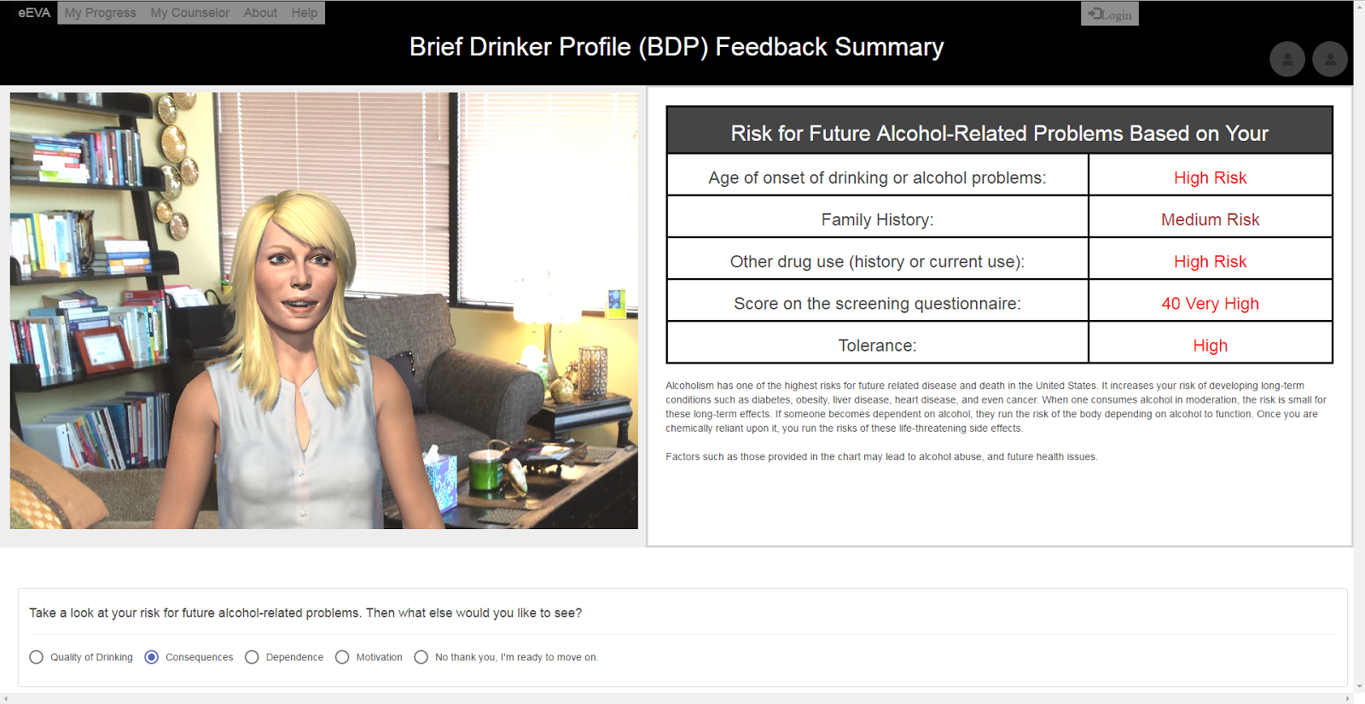
User Story #198
EditDCU_RiskFutureProblems
Revised Styling
Notes:
20 seconds
RiskFutureProblems
We originally included only the content like the basic text-only DCU, however, we later decided to improve upon it by adding

Slide 21
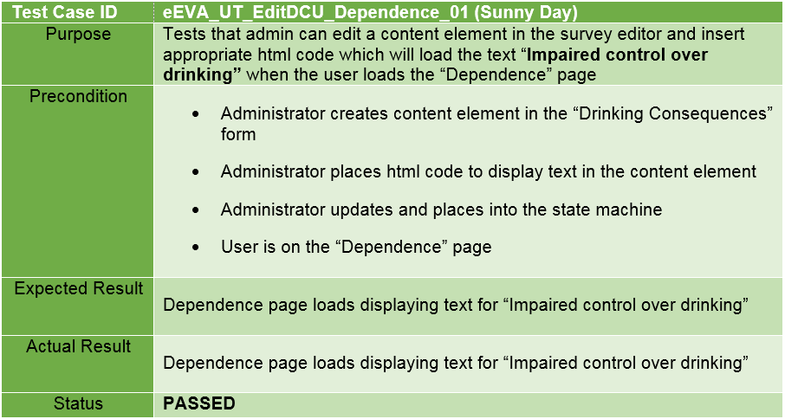
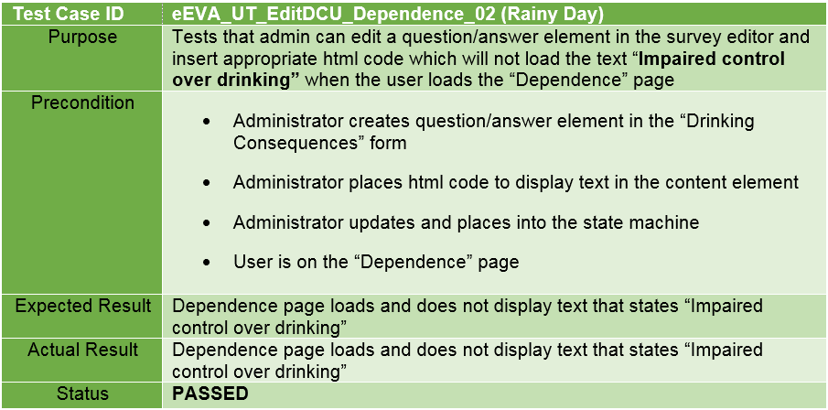
Testing eEVA
Unit Testing and Integration Testing
Notes:
10 seconds
A description of verification process and Test Suites and Test Cases for one of the use cases.
1 One sunny day and one rainy day for the implemented use cases (one or more slides).
2 Automated test scripts for the implemented use cases (if any) (one or more slides).

Slide 22
Summary
How Our Project Came Together…
MEAN Stack Implementation to produce Survey Editor and State Machine
We worked on implementation of the results section for eEVA
Along the way discovered some additional changes to the system
Utilized Agile, with daily Scrum meetings, and biweekly sprints
Additional Programs:
Mingle used to track progress
Github used to share portions of code
Google Drive used for Feature Documentation and to track Meetings
Notes:
10 seconds
Summarize your contribution, mention your effort for Scrum, Mingle, Github, Google Drive Documentation and minutes
Include your contact information
Ask if anyone has any questions for you.
Thank your audience
Please feel free to contact us to discuss this project further:
Carlos Mestre: cmest005@fiu.edu
Stephanie Lunn: slunn002@fiu.edu
Questions?
Thank You!

Slide 23

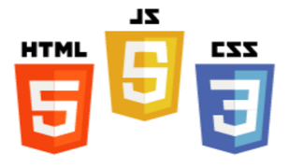




Questions?
To Contact Us:
Carlos Mestre: cmest005@fiu.edu
Stephanie Lunn: slunn002@fiu.edu
Notes:
10 seconds
Summarize your contribution, mention your effort for Scrum, Mingle, Github, Google Drive Documentation and minutes
Include your contact information
Ask if anyone has any questions for you.
Thank your audience
Please feel free to contact us to discuss this project further:
Carlos Mestre: cmest005@fiu.edu
Stephanie Lunn: slunn002@fiu.edu
Questions?
Thank You!

